Slide 1


Customized Object (Tree) Detection & 3D Localization
Khoa Nguyen
Research Assistant
3D Media Research Group (CIVIT)
‹#›

Slide 2
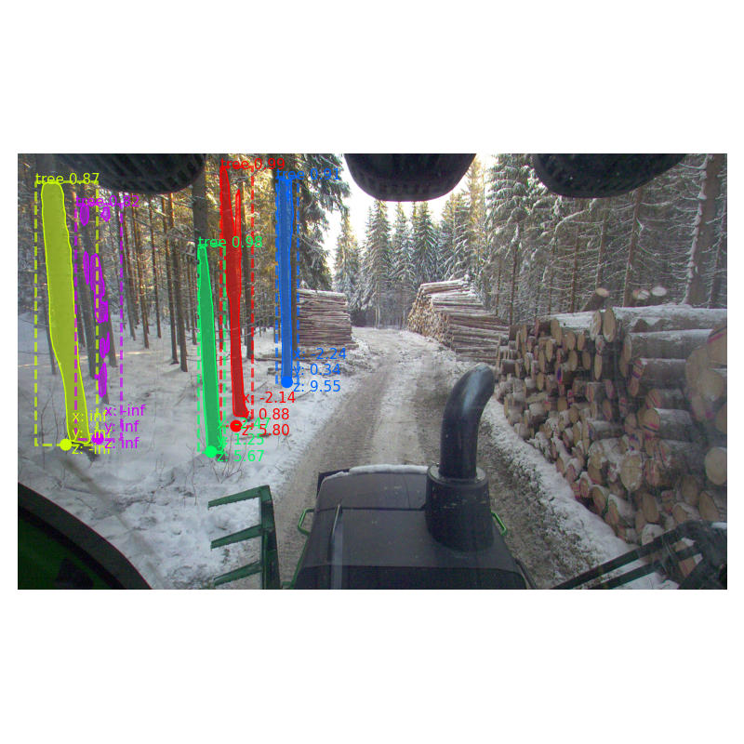
Problem Formulation
Detect the trees near to the cameras, and also give the 3d positions compared to the position of the camera.
Figure: trees detection
‹#›

Slide 3
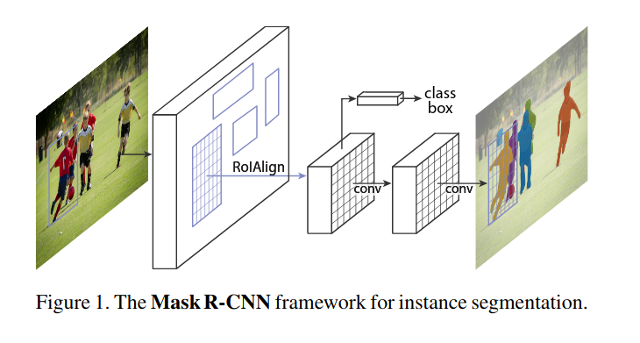
Method Overview
Figure: Mask RCNN (https://arxiv.org/pdf/1703.06870.pdf
https://github.com/matterport/Mask_RCNN)
‹#›

Slide 4
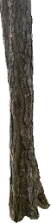
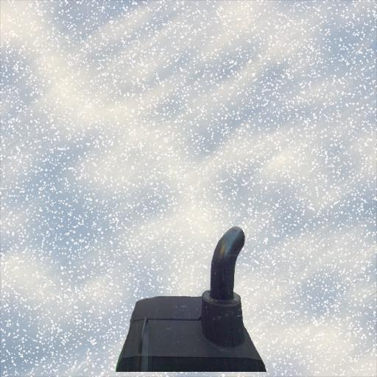
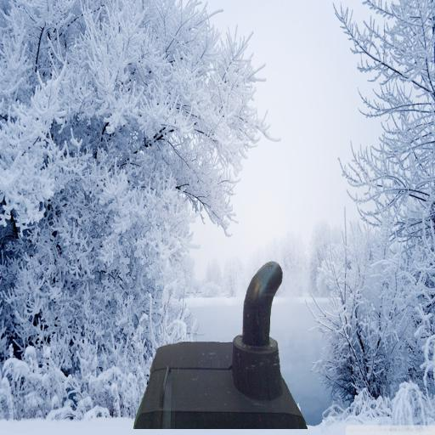
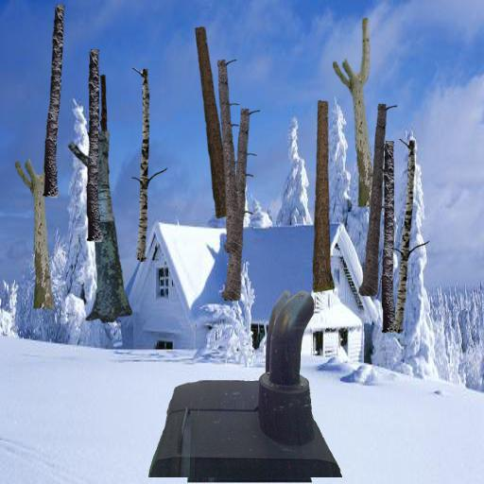
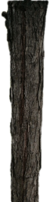
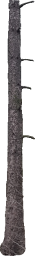
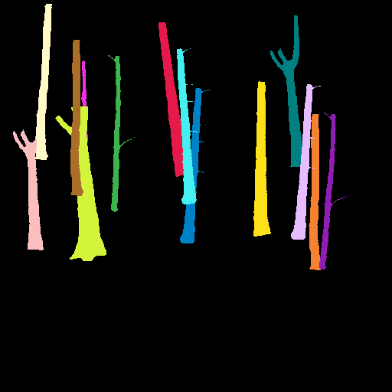
Training Data
+
=
Using synthesized dataset following the COCO dataset format (http://cocodataset.org/#home).
‹#›

Slide 5
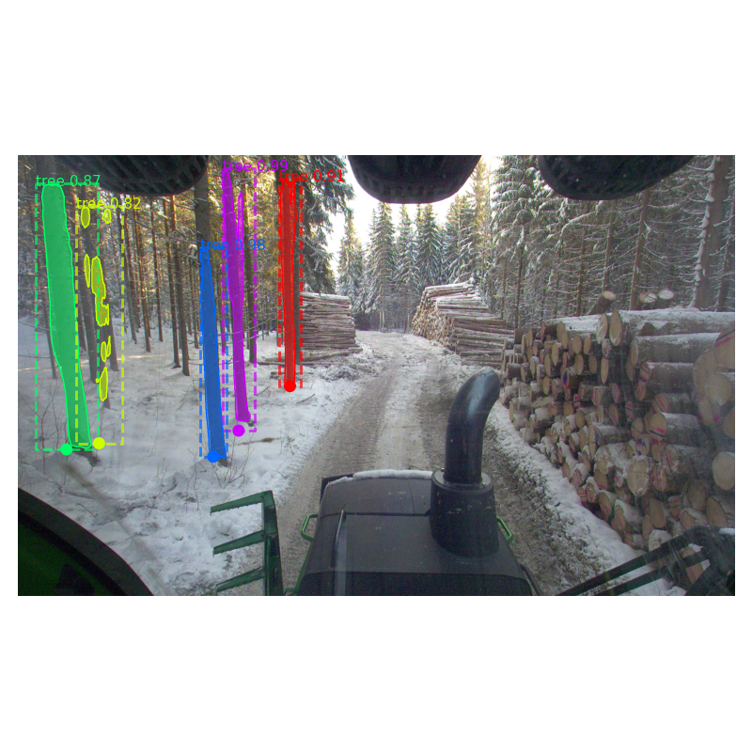
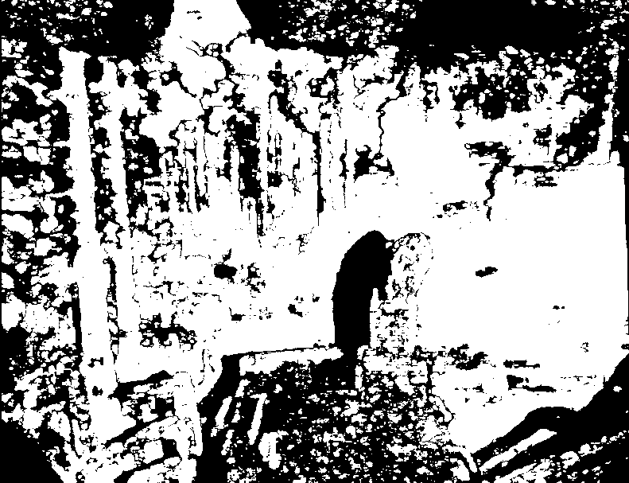
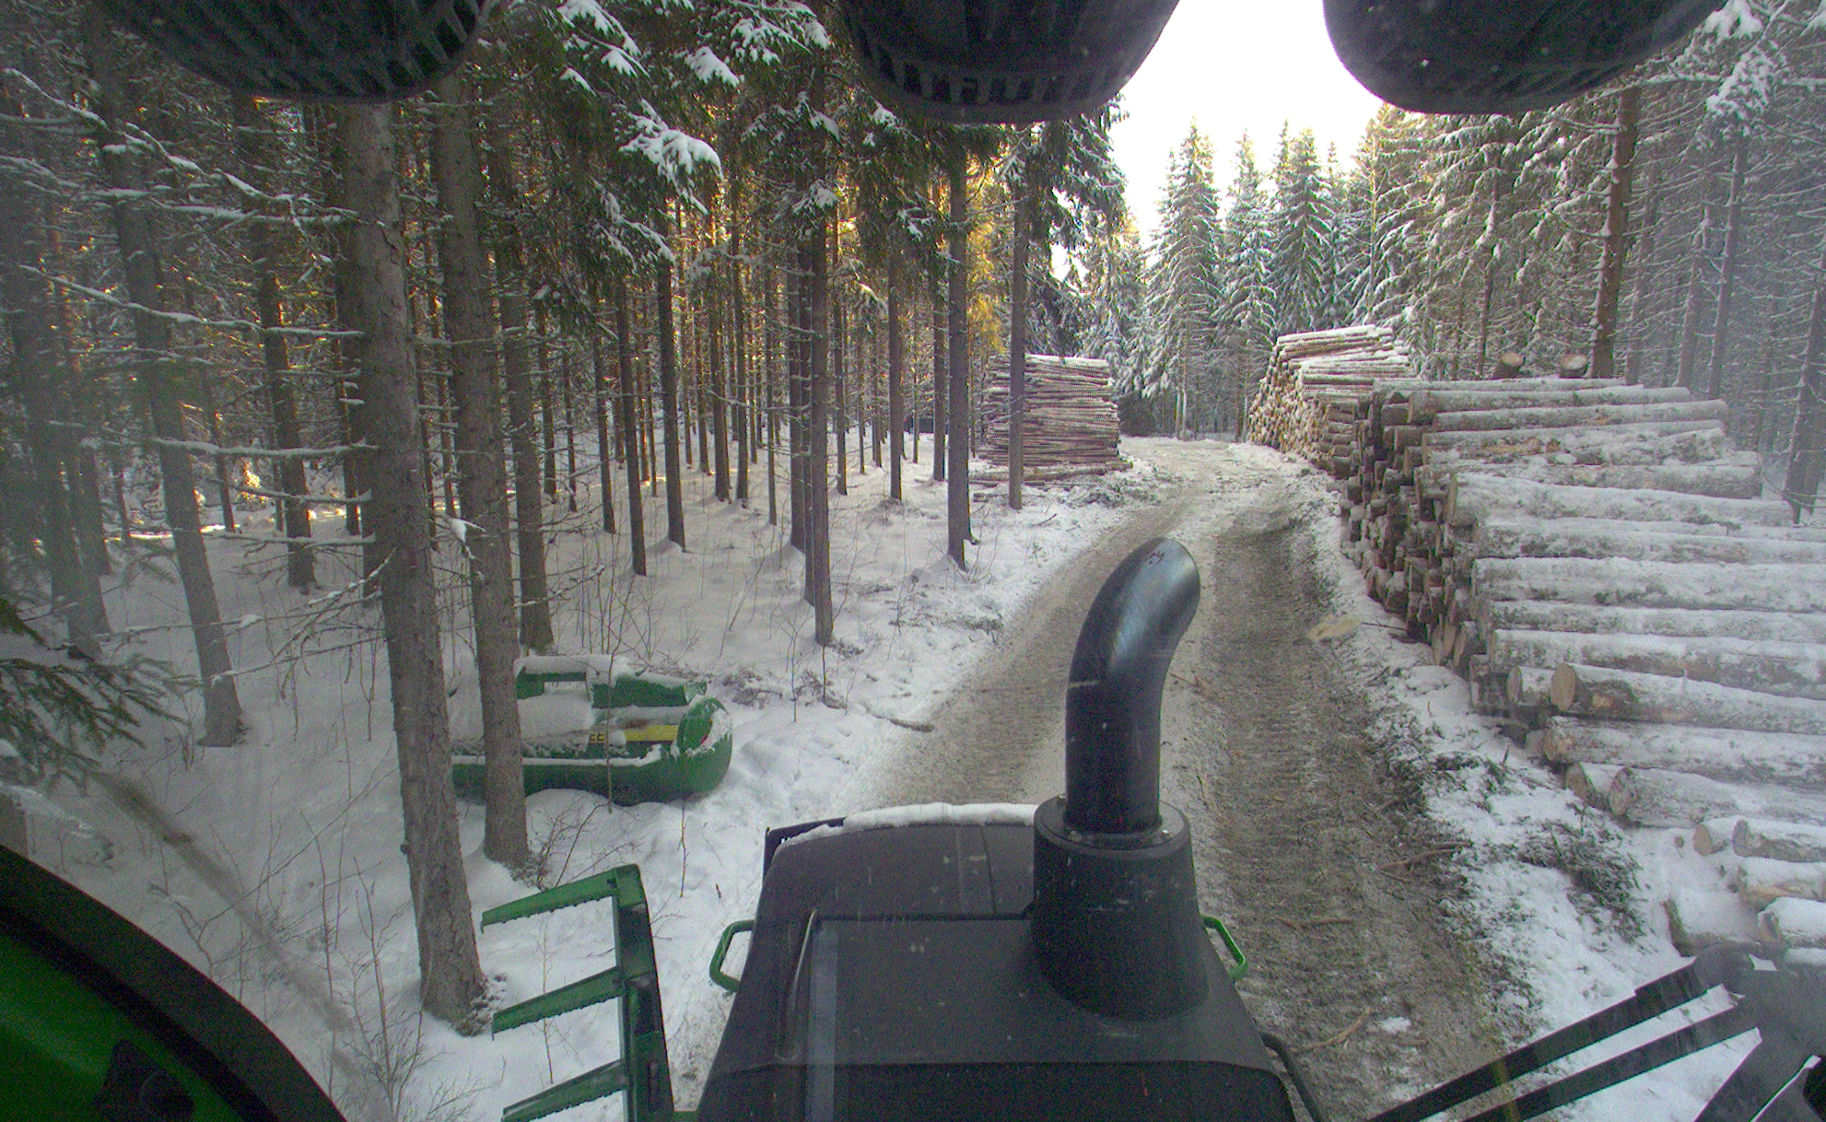
Testing data & doing inference
3d reconstruction
Trained Mask-RCNN
Test data
Result
‹#›

Slide 6
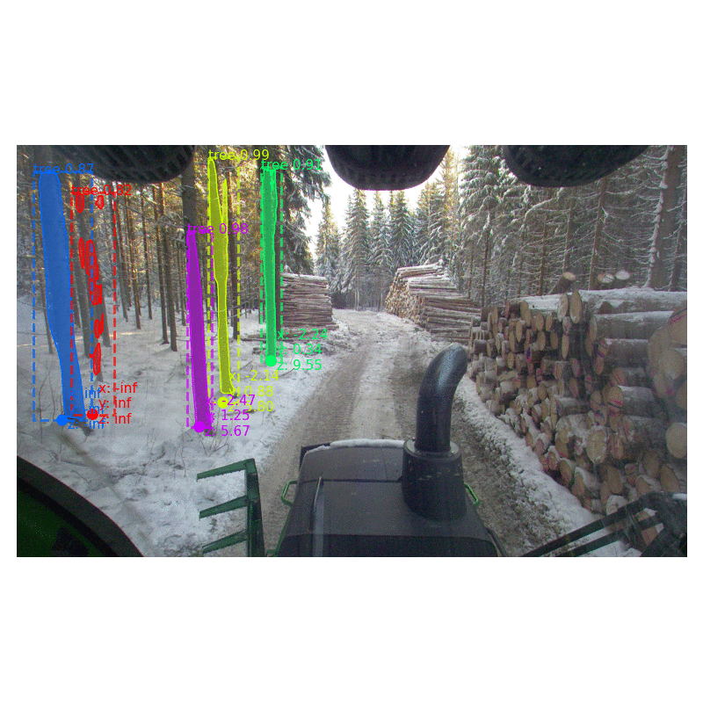
A small demo
‹#›

Slide 7
Conclusions
With the method of synthesized dataset and Mask-RCNN, the algorithm can actually detect any objects.
With all the data needed (rectified images, 3d points, disparity maps), the results could be generated in real time with optimizations (currently runs at ~1s for 1 output frame, on GTX-1080Ti, CPU Intel Xeon 3.7Hz).
‹#›

Slide 8
Thank you, that’s all!
‹#›

